Slide 1
Are magnetic fields and outflows aligned in protostellar cores?
Chat Hull
University of California, Berkeley
Radio Astronomy Laboratory
8 July 2013
CARMA Science Symposium
University of Chicago
Chicago, Ill.
Notes:
Star formation regions

Slide 2
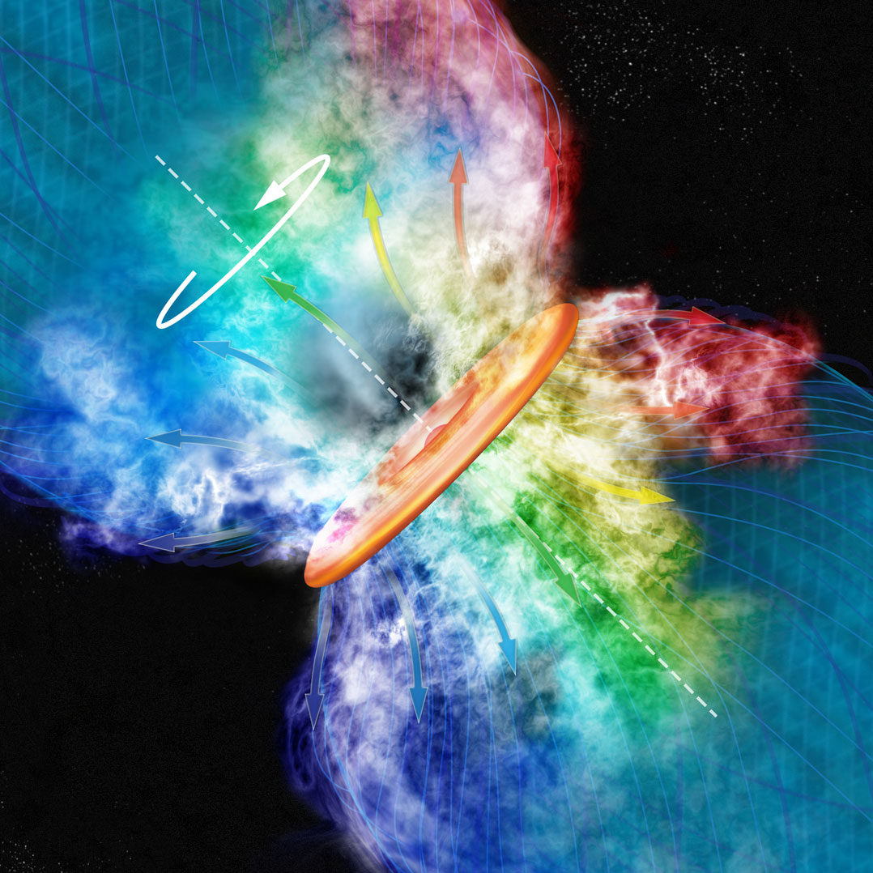
Credit: Bill Saxton, CfA

Slide 3
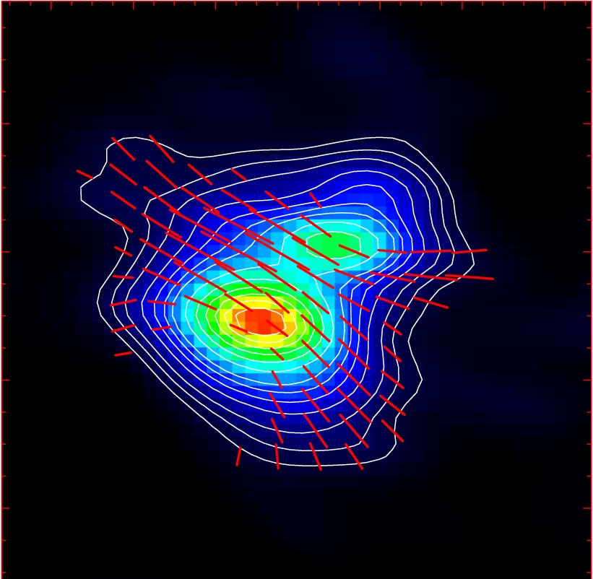
Misalignment of B-fields and outflows
IRAS 16293
NGC 1333-IRAS 4A
B-field
Rao+ 2009
Girart+ 2006
Outflow
Notes:
ROTATION: IRAS 16293 has rot/grav < 0.1; IRAS4A seems the same (barely any rotation); VLA 1623 questionable (probably slow)
-Holland: JCMT data
-Rao, Girart: SMA
-This is okay, according to Hennebelle & Ciardi ‘09 (easier to form disks with obliquity!)
-Ward-Thompson et al (2009) saw a 30 deg offset between short axes of cores and their polarization directions…another problem!

Slide 4
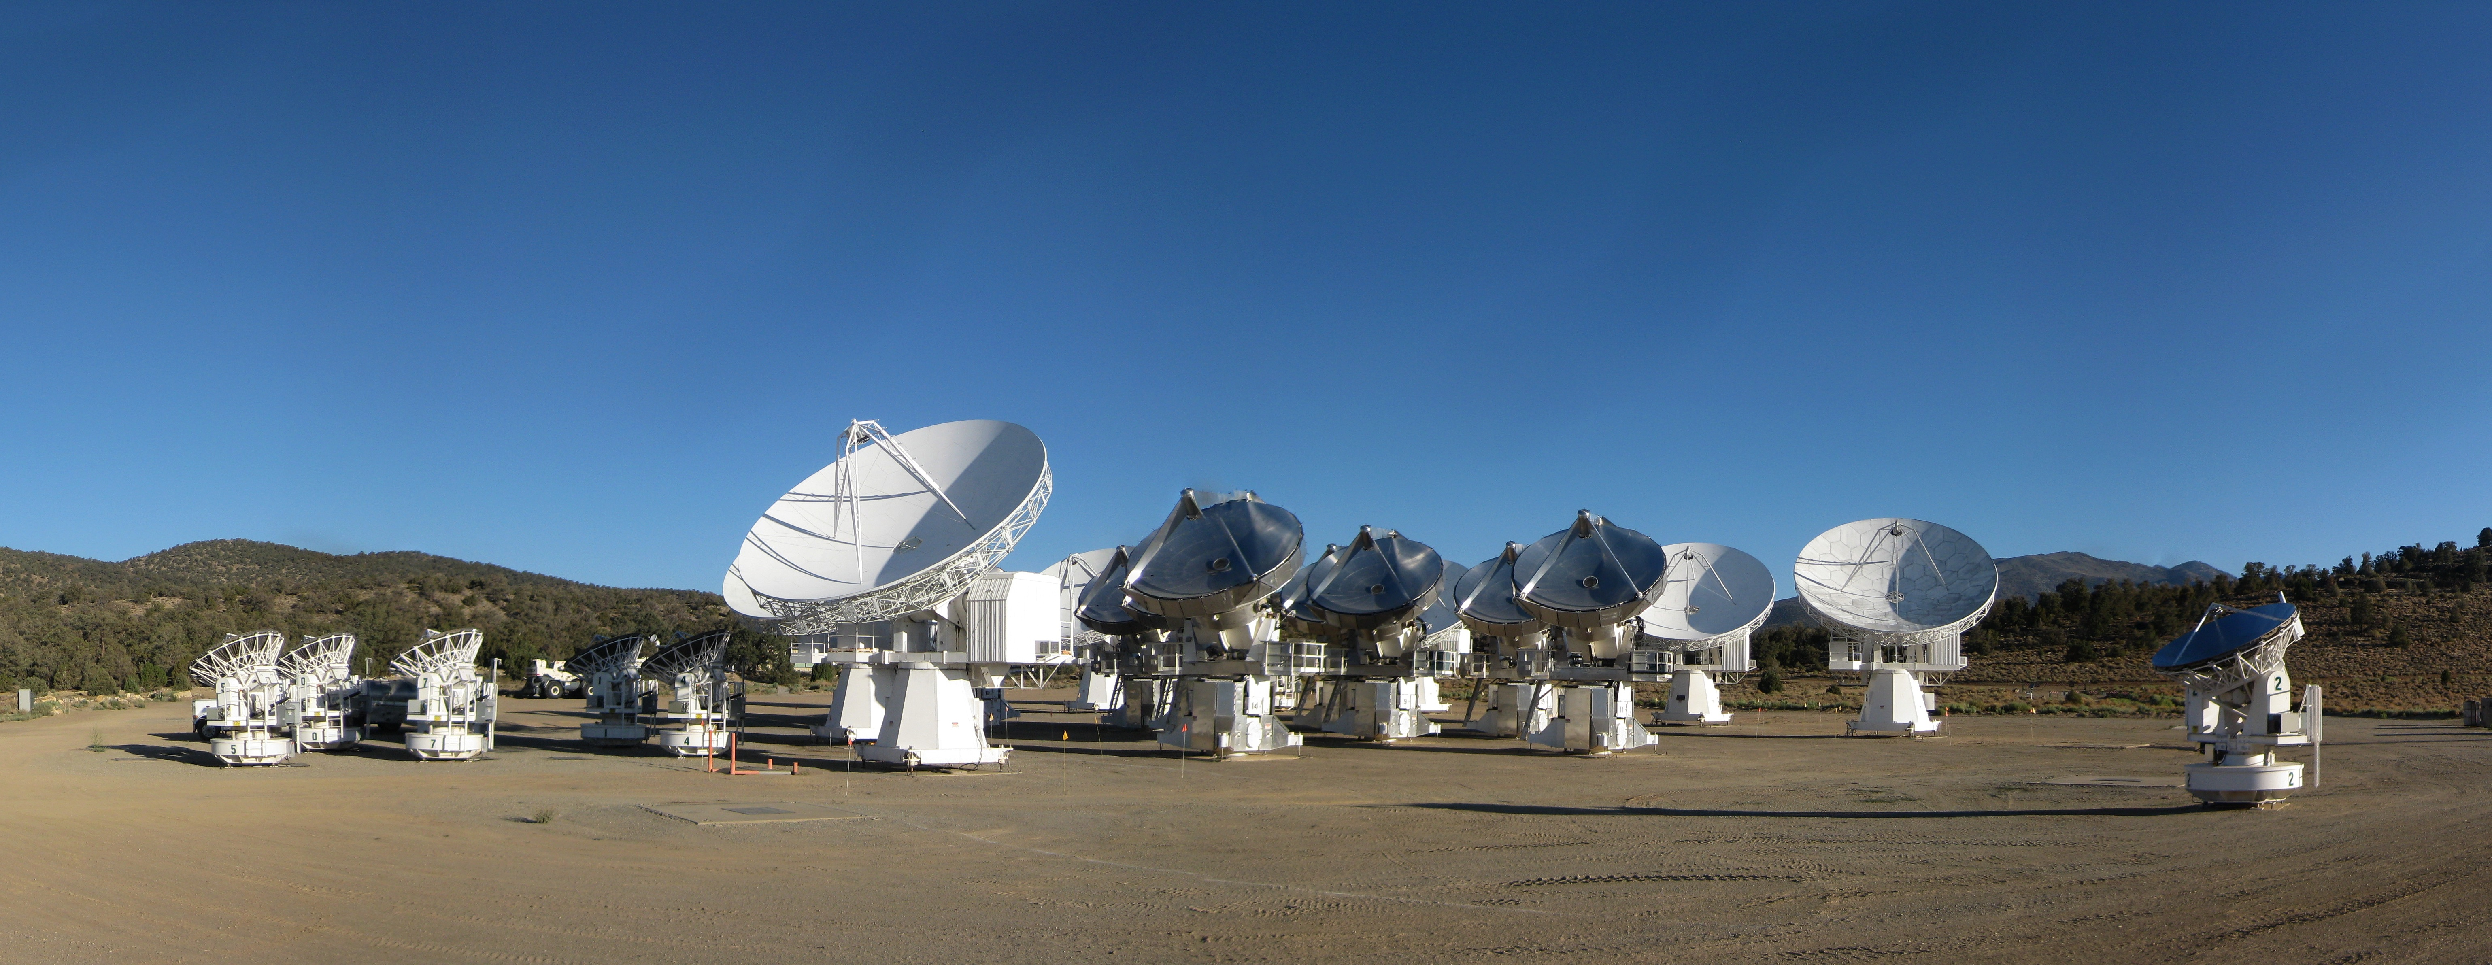
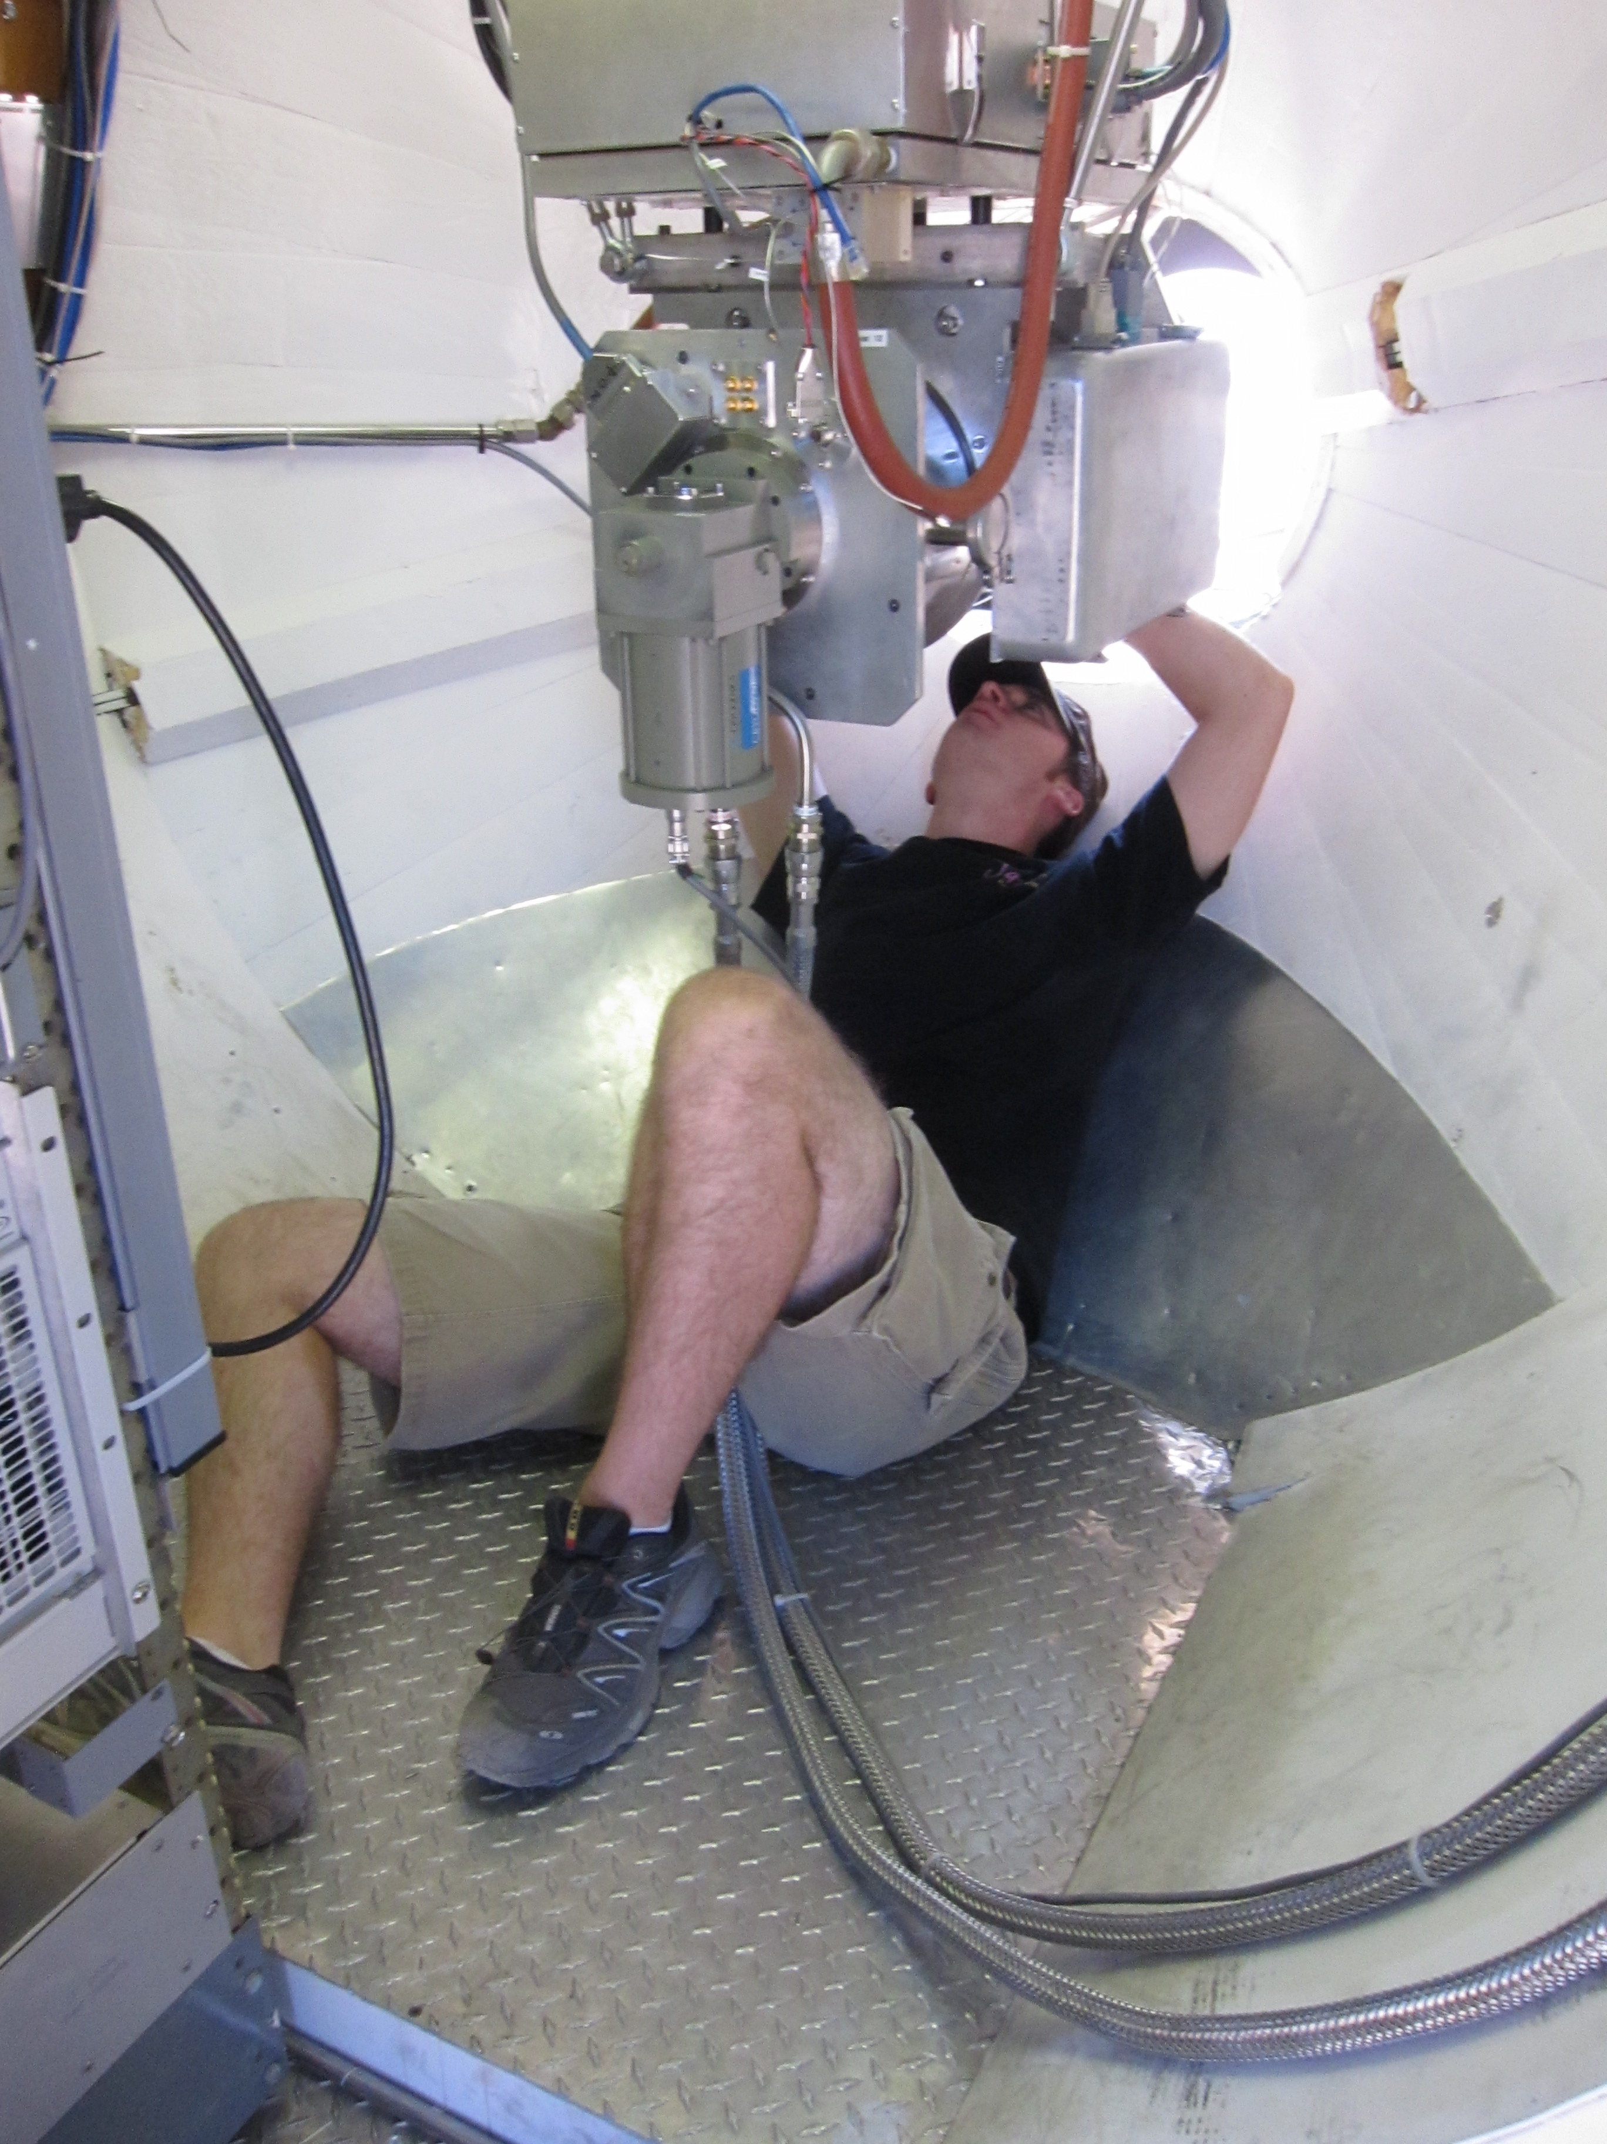
CARMA Combined Array for Research in Millimeter-wave Astronomy Consortium: Berkeley, Caltech, Illinois, Maryland, Chicago
6 ⨯10-m, 9 ⨯ 6-m, 8 ⨯ 3.5-m telescopes
Observations at 1 cm, 3 mm, and 1 mm (polarization!)
Located in Cedar Flat, CA (near Bishop)
Notes:
SMA: 8*6m antennas = 226 m^2
CARMA: 6*10m, 9*6m = 726 m^2 (more than factor of 3 more area)
-Factor of two more dishes
-Equivalent T_sys?

Slide 5
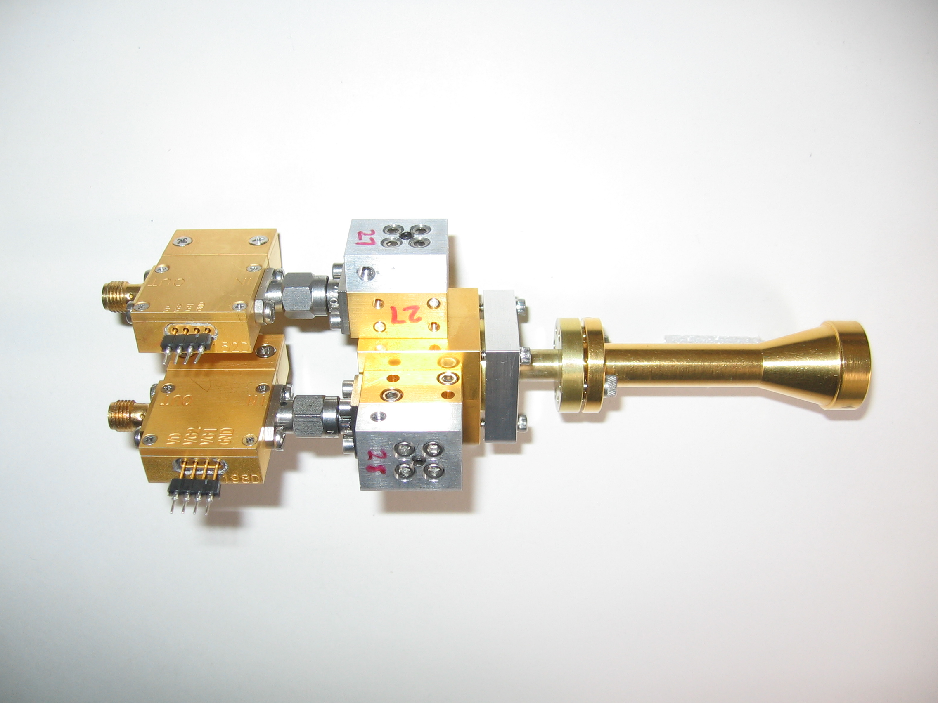
1 mm dual-polarization receivers
SIS mixers
Orthomode transducer
Waveguide circular polarizer
1 inch
WBA13
I.F. amplifiers (1-9 GHz)
Credit: Dick Plambeck
Notes:
-Sensitive to RCP & LCP
-Null experiment: in the absence of linear polarization, you get no RL correlation at any time.
-If you have linear feeds, you have XY correlation sometimes (when the intrinsic polarization is at 45º to your two feeds), and not other times (when it’s along one feed or the other). Thus, to tease out the polarization, you need stable gains

Slide 6
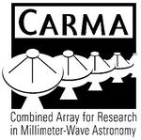












TADPOL collaboration
UC Berkeley
Chat Hull (PI), Dick Plambeck, Mel Wright, Carl Heiles, Geoff Bower
University of Maryland
Marc Pound, Alberto Bolatto, Katherine Jameson,
Lee Mundy
Caltech
Thushara Pillai, John Carpenter, James Lamb,
Nikolaus Volgenau
University of Illinois, Urbana-Champagne
Ian Stephens, Leslie Looney, Woojin Kwon,
Dick Crutcher, Nick Hakobian
Other
Dan Marrone (Arizona), Meredith Hughes (Wesleyan), John Vaillancourt & Göran Sandell (USRA-SOFIA), John Tobin (NRAO), Jason Fiege (Manitoba),
Erica Franzmann (Manitoba), Martin Houde (UWO, Caltech), Brenda Matthews (NRC-CNRC)

Slide 7
TADPOL survey
37 sources
Triples number of interferometric polarization maps
~300 observing hours
CARMA C, D, & E arrays
1 – 4" resolution
10⨉ higher resolution than CSO & JCMT
Probes intermediate region between ~0.1 pc (single-dish)
and ~100 AU (ALMA)

Slide 8
TADPOL results
L1157
2″
See also: Stephens+ 2013, ApJL, 769, L15
Notes:
NEARBY SF regions:
-Perseus (NGC 1333, L1448, SVS13): 235 pc (masers in SVS13) → 03:30 LST
-Taurus (DG Tau, L1527): 140 pc → 04:30 LST
-Orion: 400 pc → 05:30 LST
-Serpens: 415 pc → 18:30 LST
-Ophiuchus: 140 pc → 17:00 LST
-Cepheus (L1157): 250 pc → 22:00 LST
-Isolated (B335, Bok globule): 250 pc

Slide 9
Credit: Bill Saxton, CfA

Slide 10
TADPOL results
NGC 1333-IRAS 4A
NGC 1333-IRAS 4B
2″
2″
Notes:
NEARBY SF regions:
-Perseus (NGC 1333, L1448, SVS13): 235 pc (masers in SVS13) → 03:30 LST
-Taurus (DG Tau, L1527): 140 pc → 04:30 LST
-Orion: 400 pc → 05:30 LST
-Serpens: 415 pc → 18:30 LST
-Ophiuchus: 140 pc → 17:00 LST
-Cepheus (L1157): 250 pc → 22:00 LST
-Isolated (B335, Bok globule): 250 pc

Slide 11
TADPOL results
L1527
NGC 1333-IRAS 2A
2″
3″
Notes:
NEARBY SF regions:
-Perseus (NGC 1333, L1448, SVS13): 235 pc (masers in SVS13) → 03:30 LST
-Taurus (DG Tau, L1527): 140 pc → 04:30 LST
-Orion: 400 pc → 05:30 LST
-Serpens: 415 pc → 18:30 LST
-Ophiuchus: 140 pc → 17:00 LST
-Cepheus (L1157): 250 pc → 22:00 LST
-Isolated (B335, Bok globule): 250 pc

Slide 12
TADPOL results
Ser-emb 8
3″
Notes:
NEARBY SF regions:
-Perseus (NGC 1333, L1448, SVS13): 235 pc (masers in SVS13) → 03:30 LST
-Taurus (DG Tau, L1527): 140 pc → 04:30 LST
-Orion: 400 pc → 05:30 LST
-Serpens: 415 pc → 18:30 LST
-Ophiuchus: 140 pc → 17:00 LST
-Cepheus (L1157): 250 pc → 22:00 LST
-Isolated (B335, Bok globule): 250 pc

Slide 13
Outflow vs. B-field: distribution
Simulation: outflows & B-fields aligned within a 20º cone (tightly aligned)
Simulation: outflows & B-fields are randomly oriented
Cumulative Distribution Function (CDF)
Simulation: outflows & B-fields aligned between 70–90º (preferentially misaligned)
KS-test results:
20º cone ruled out ( p-value ~ 10⁻¹⁵ )
Misaligned ( 0.33 ) and random ( 0.33 ) cannot be ruled out
Hull+ 2013, ApJ, 768, 159
(updated version: July ‘13)
(Projected) angle between outflow & B-field (deg)

Slide 14
Pre-summary: poster teaser
Notes:
Other TADPOL future possibilities:
Intrinsic modeling of B-fields in cores (Fiege)
Constraints on B-fields in protoplanetary disks (Hughes)
Turbulence power spectra (Houde)
Larger scale background-star maps (Mimir, Jameson/Pillai/Clemens)

Slide 15
Pre-summary: poster teaser
Notes:
Other TADPOL future possibilities:
Intrinsic modeling of B-fields in cores (Fiege)
Constraints on B-fields in protoplanetary disks (Hughes)
Turbulence power spectra (Houde)
Larger scale background-star maps (Mimir, Jameson/Pillai/Clemens)

Slide 16
Summary
TADPOL results: B-fields are either preferentially misaligned (perp.) or randomly aligned with respect to outflows at the ~1000 AU scale
Thus, circumstellar disks are misaligned with fields in the cores from which they formed
CARMA 1 mm polarization system is online and accepting proposals
Data release coming soon!
TADPOL first results: ApJ, 768, 159
TADPOL survey (CARMA key project): tadpol.astro.illinois.edu
Notes:
Other TADPOL future possibilities:
Intrinsic modeling of B-fields in cores (Fiege)
Constraints on B-fields in protoplanetary disks (Hughes)
Turbulence power spectra (Houde)
Larger scale background-star maps (Mimir, Jameson/Pillai/Clemens)

Slide 17
Fin

